Slide 1
LLM Risk Navigator
Team Patriots
3rd May 2024

Slide 2
team Patriots
Baba Akhil Sarvasiddhy Product Owner
Davon Carvalho Developer
Vishnu Vasireddy Developer
Charan Reddy Bobbala Developer
Aakash Aundhkar Developer, Quality Manager
Susmith Poreddy Scrum Master

Slide 3

Project Goals
Large Language Models(LLMs)
LLMs are advanced artificial intelligence systems.
They are trained on extensive text data to understand and generate human-like language.
LLMs are revolutionizing various language-related tasks and applications.
Example:
ChatGPT by OpenAI
Llama by Meta
Gemini by Google

Slide 4



Project Goals
Security Concerns with LLM
As the demand for LLM integration into various business systems rises, there emerges an imperative for thorough security assessments to accompany their deployment
Malwares
Malware, malicious software designed to infiltrate and disrupt computer systems, poses a serious threat to LLMs, compromising their functionality and integrity.
Model Extraction
Model extraction involves an adversary probing a black box machine learning system to extract the data it was trained on
Hacking
The unauthorized
access, manipulation, or exploitation of a Large Language Model system for malicious purposes.

Slide 5
Project Goals
Project Goals
By analyzing known attack vectors and innovating tailored risk assessment methodologies, industries can proactively address security concerns, thereby minimizing the risk of data breaches, misinformation dissemination, and other malicious activities.​
Attack Vectors Identification
Assessing Risk for each Attack vector
Develop a Risk Matrix
The development of an industry-specific risk matrix enables organizations to prioritize mitigation efforts based on the severity and likelihood of potential attacks, empowering them to navigate the complexities of LLM integration with confidence and resilience.​
The development of an industry-specific risk matrix enables organizations to prioritize mitigation efforts based on the severity and likelihood of potential attacks, empowering them to navigate the complexities of LLM integration with confidence and resilience​.

Slide 6
Understanding Risk Assessment
Increase in LLM Attacks
Following the launch of ChatGPT 3.5 in November 2022, there has been a notable increase in news articles reporting on attacks targeting Large Language Models (LLMs).
= Launch of ChatGPT 3.5

Slide 7
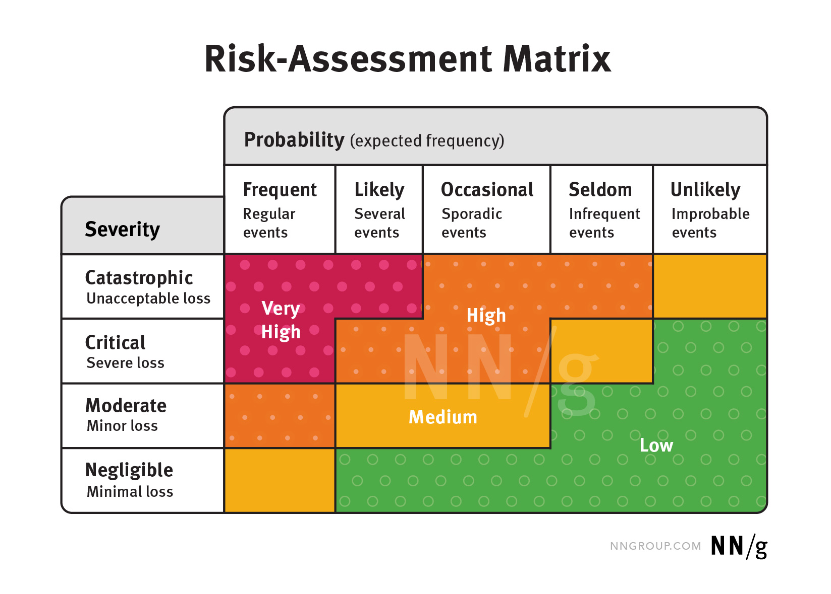
Understanding Risk Assessment
What is Risk Assessment?
Risk assessment is a structured process for identifying, evaluating, and prioritizing potential risks associated with LLM implementation, depicted visually through a risk assessment matrix to facilitate targeted mitigation strategies.
Why do Risk Assessment?
Proactive Prevention
Compliance
Resource Allocation
Trust and Reputation

Slide 8



Risk assessment
Main Components of Risk Assessment
Threat:
A potential cause of an unwanted incident, which may result in harm to a system or organization.
Eg: Cyber attacks
Vulnerability:
A weakness or gap in protection efforts that can be exploited by threats to gain unauthorized access or cause harm.
Eg: Inadequate security policies
Consequence:
The impact or outcome of an event being realized, affecting the objectives or assets of the organization.
Eg: Financial loss
Notes:
Proactive Prevention: Helps in anticipating and preventing incidents before they occur.
Compliance: Ensures adherence to laws, regulations, and industry standards.
Resource Allocation: Aids in efficient allocation of resources to where they are most needed to manage risks.
Trust and Reputation: Builds stakeholder trust and maintains organizational reputation by demonstrating commitment to safety and risk management.

Slide 9
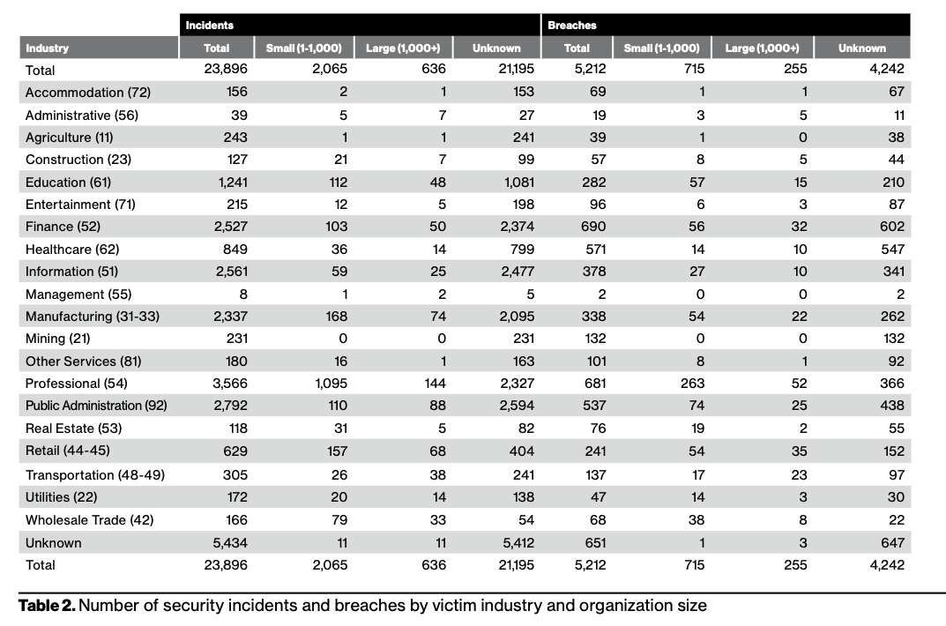
Datasets used:
VERIS Community Database (VCDB)
The VERIS VCDB database categorizes cybersecurity incidents, providing a valuable resource for organizations to analyze trends and inform risk mitigation strategies.
This database consists of around 10k records.
We will use this to get the frequency of LLM-related attacks.

Slide 10
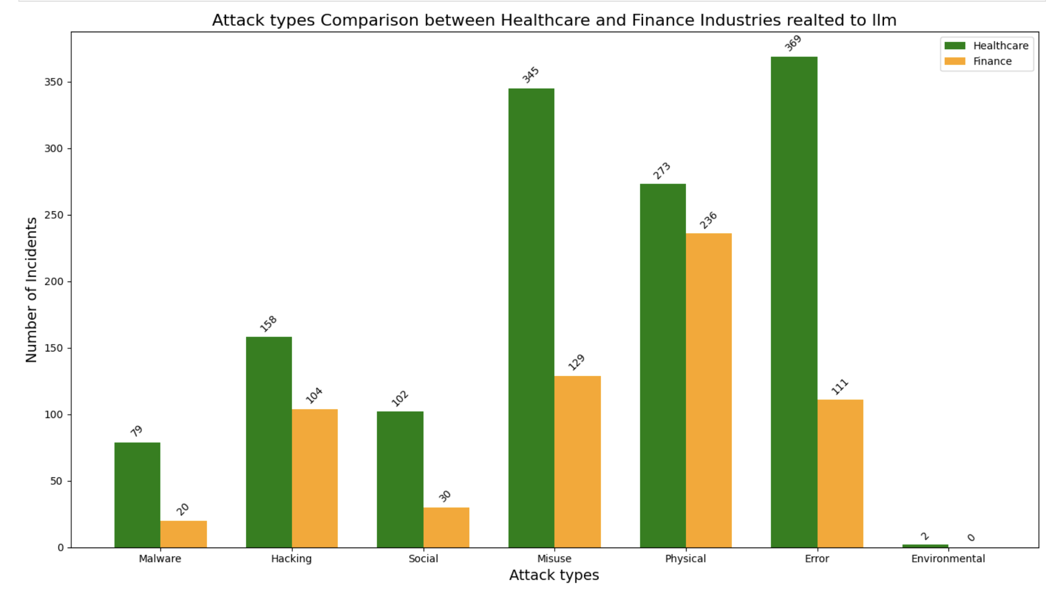
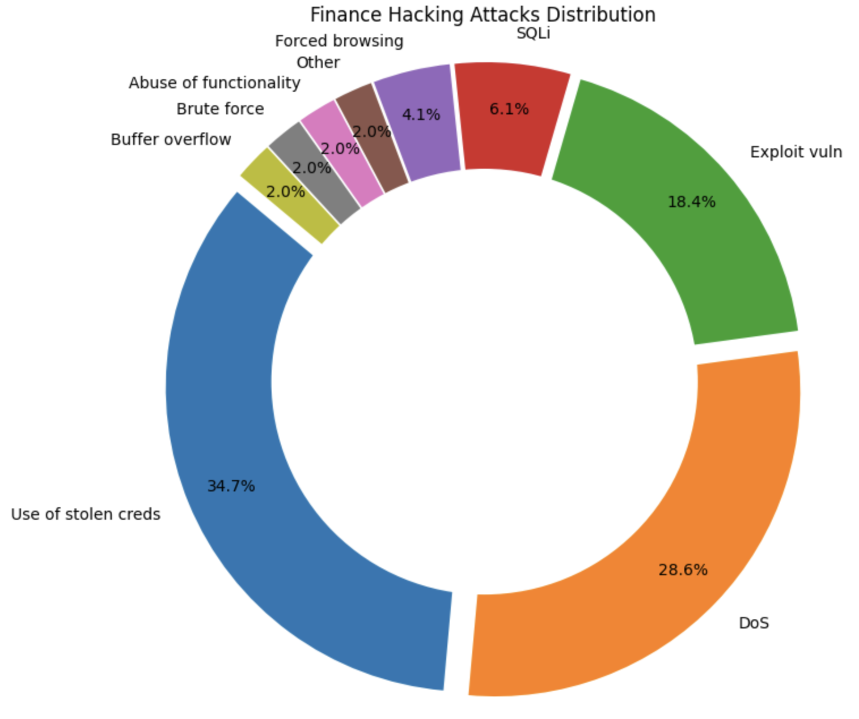
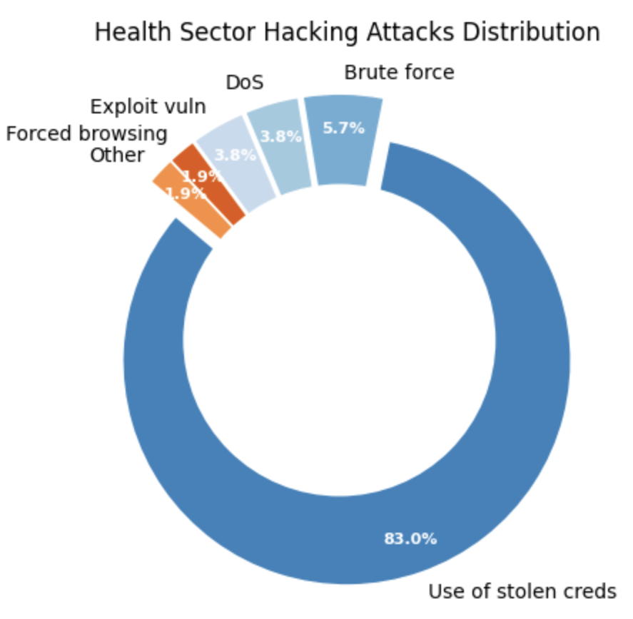
Analysis of veris database
The pie charts on the right give a detailed report of how the process of hacking is done in both health and finance sectors.

Slide 11
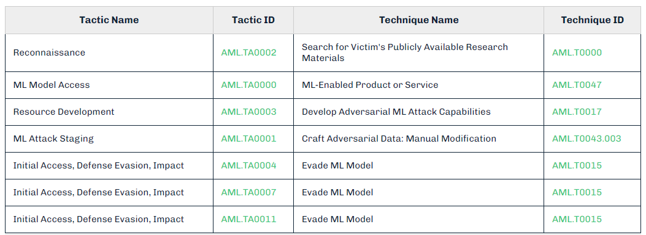
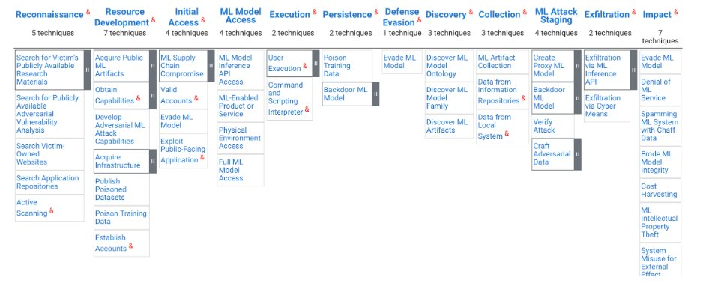
Datasets used:
What is MITRE ATLAS?
MITRE ATLAS is a globally accessible database of adversary tactics and techniques observed in real-world AI system attacks, providing valuable insights for cybersecurity professionals.
This database has around 75 LLM attack vectors.
We will use this database to get various LLM attack techniques.

Slide 12
Datasets used:
Census Data
NAICS CODES | INDUSTRIES
11 | Agriculture, Forestry, Fishing and Hunting
211 | Oil and Gas Extraction
315 | Apparel Manufacturing
54161 | Technical Consulting Services
61142 | Computer Training
62 | Healthcare
541512 | Computer Systems Design Services
Census Data has NAICS code for each industry
These NAICS codes are used to uniquely identify the industrial sector of each business
VCDB has attacks grouped by industrial NAICS codes
NAICS codes will help us to analyze the LLM attacks by its sectors.
Notes:
Proactive Prevention: Helps in anticipating and preventing incidents before they occur.
Compliance: Ensures adherence to laws, regulations, and industry standards.
Resource Allocation: Aids in efficient allocation of resources to where they are most needed to manage risks.
Trust and Reputation: Builds stakeholder trust and maintains organizational reputation by demonstrating commitment to safety and risk management.

Slide 13
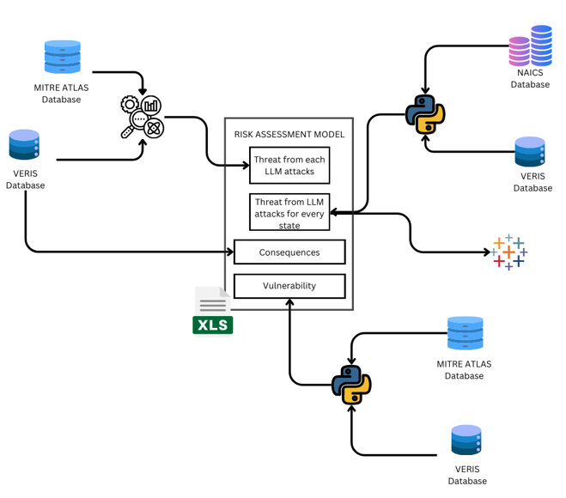
Project Architecture

Slide 14
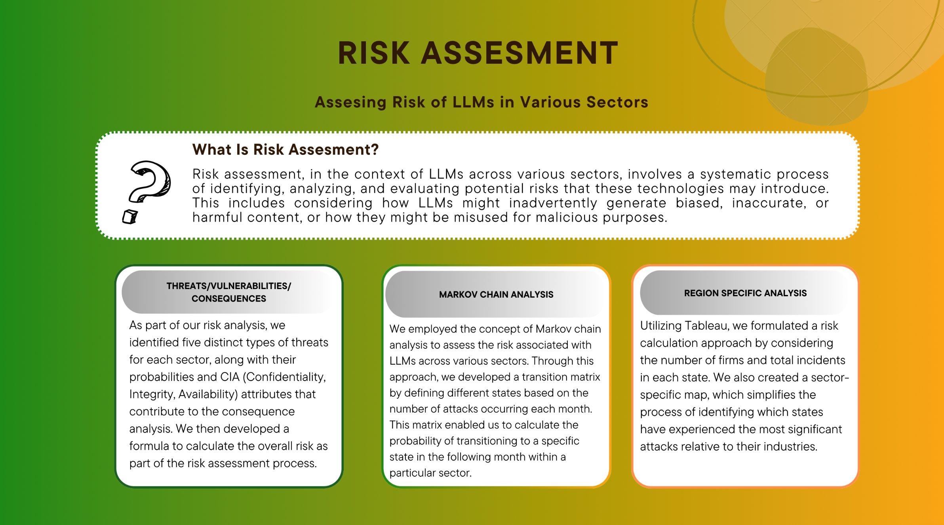
Risk analysis

Slide 15
How exactly mapping works?
MITRE ATLAS + VERIS
VERIS ATTACKS
This entails the use of software that permits remote, malicious computer control.
action.hacking.vector.Desktop sharing software
ATLAS Techniques
Mapping
Black-Box Transfer
This involves surreptitiously setting up a remote-control mechanism for a computer, usually to steal data or carry out other attacks.
action.malware.variety.Backdoor or C2
Hackers can breach a system without having to understand every technical aspect of how the computer or network functions by identifying and exploiting hidden vulnerabilities.
action.malware.variety.Backdoor
Focuses on finding a way around standard security to create a concealed entry into a computer or network.
Bidirectional mapping between VERIS and MITRE ATLAS

Slide 16
Risk Analysis- Threat
This category includes techniques that involve the preparatory steps for conducting more targeted attacks, including the development of capabilities and the acquisition of necessary tools or data.
Attack Preparation and Development
Data and Model Targeting Attacks
These attacks directly target data integrity or manipulate ML models to corrupt, exploit, or steal data and model functionality.
LLM Threats
Resource and Service Disruption
This category focuses on attacks that primarily aim to disrupt services or exhaust resources, whether computational or financial.
Exploitation and Exfiltration
Deception and Intrusion
These techniques exploit system vulnerabilities to perform unauthorized actions or exfiltrate data, including financial and intellectual property theft.
These attacks involve deception tactics to gain unauthorized access or gather information, often using social engineering or phishing.

Slide 17
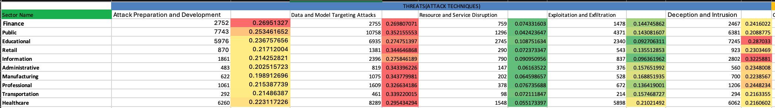
Risk Analysis- Threat
For each sector , we calculated frequency of different LLM threats that we came up and calculated probability of each attack in every industry.
Merged consequences table of risk analysis.
Analyzed the most probable type of attacks related to LLM by calculated probability of attack in each industry.
Threats probability calculation

Slide 18
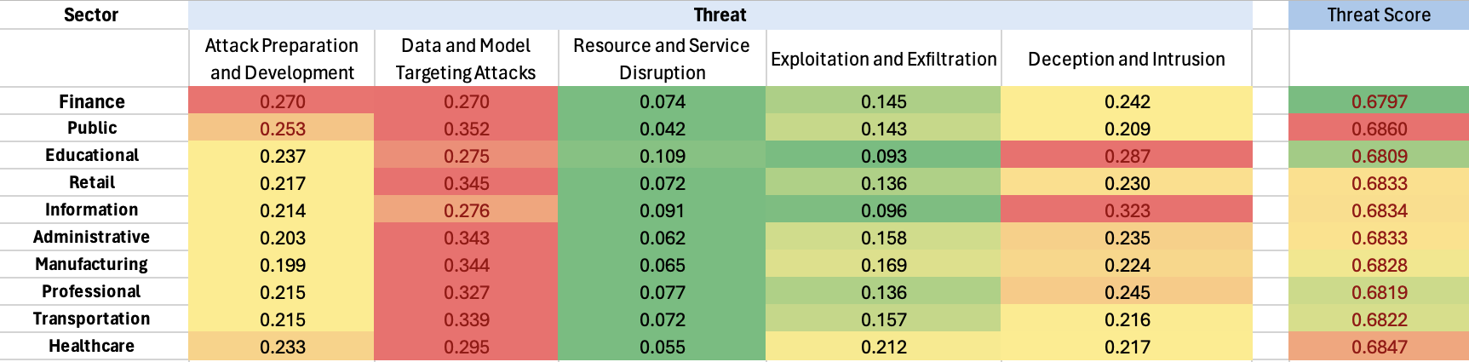
Risk analysis-threat
Threat Score(sector) = 1− _{i=1}∏^{n} (1−P(Event i)
For each sector , we calculated threat scores and rounded it up to 4 digits.
If we examine the threat scores by sector, Public and Healthcare emerge as the most concerning sectors.

Slide 19
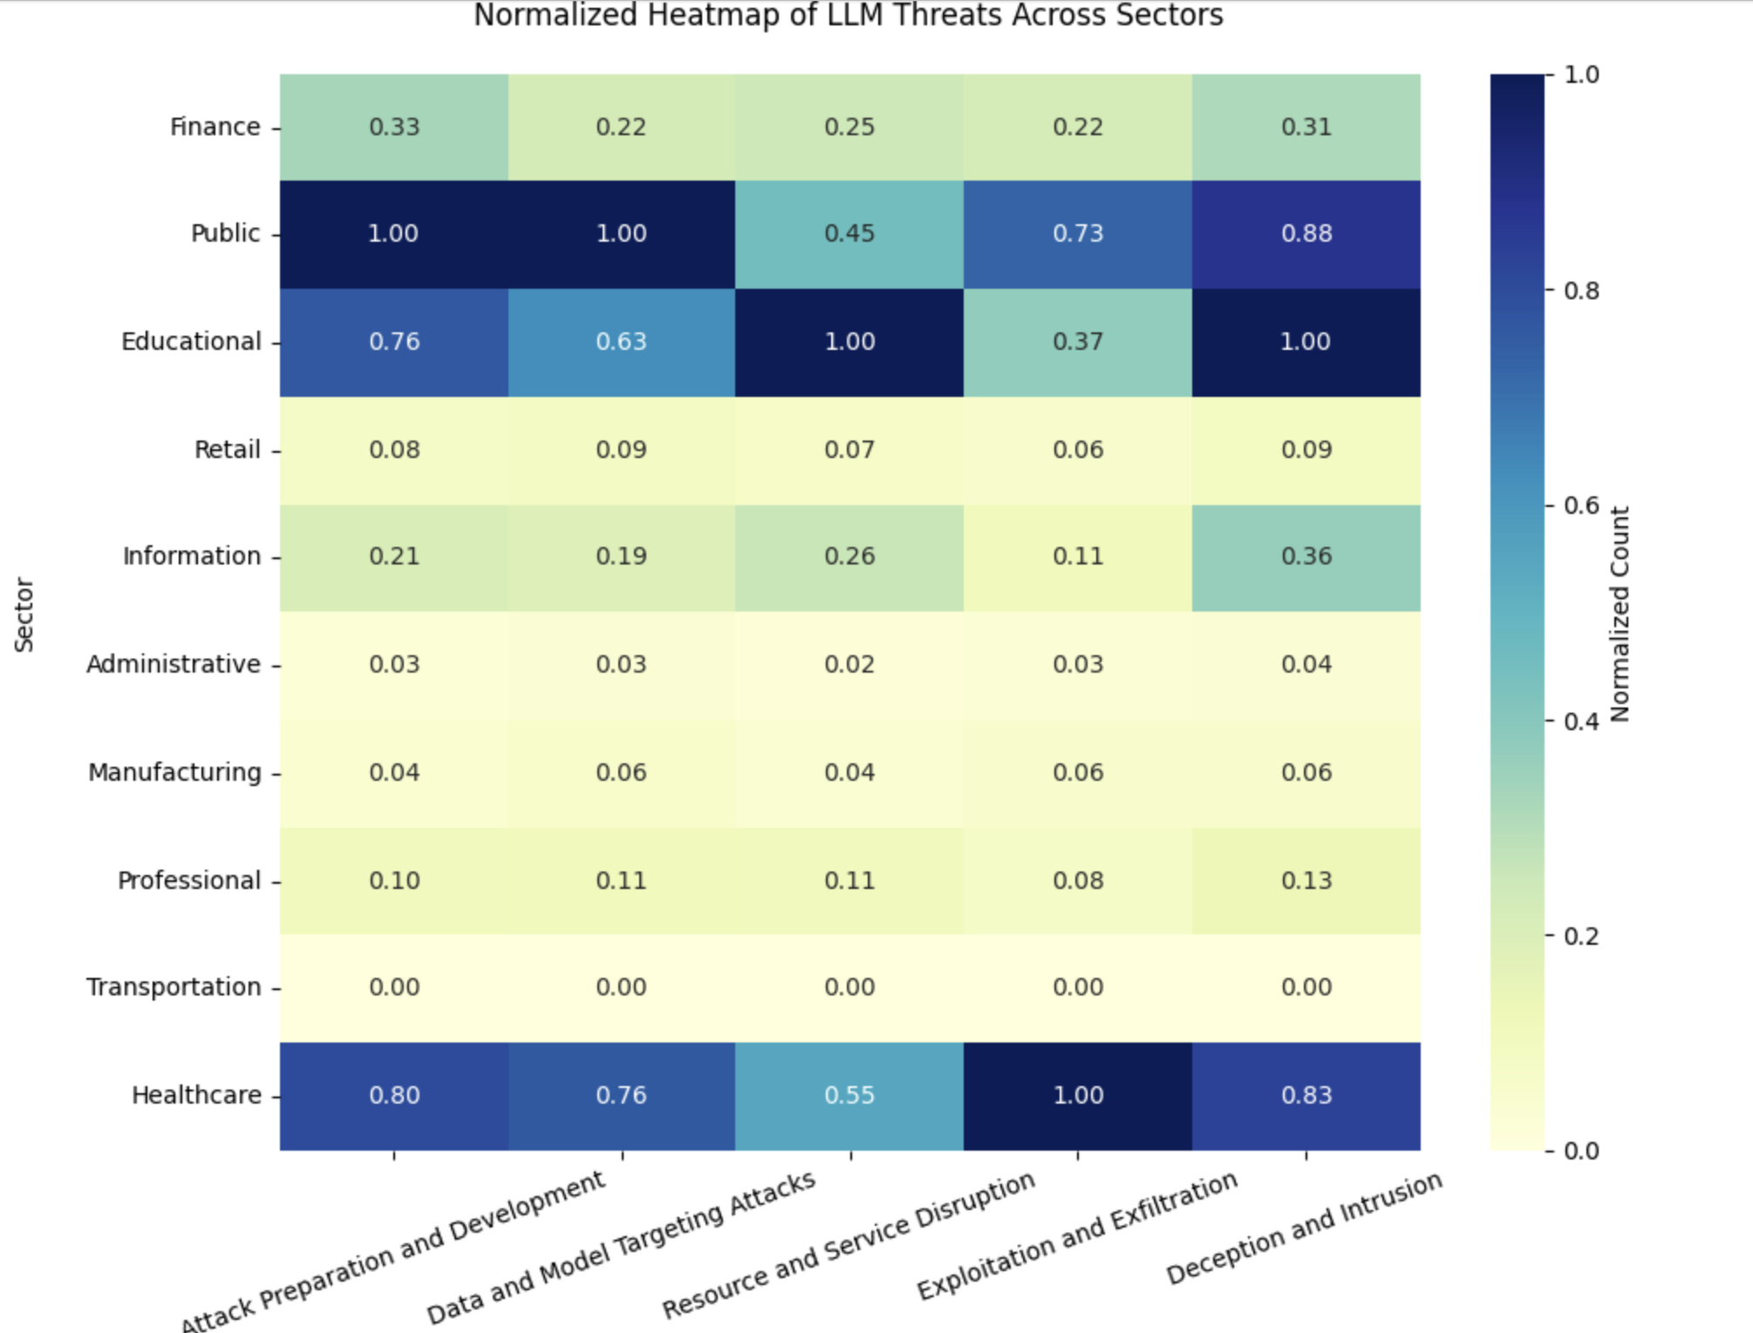
Analysis of threats across different sectors
This heatmap provides a visual representation of the relative frequency of different types of threats faced by various sectors due to large language models (LLMs).
The color gradient reflects the normalized count of each threat type, with darker shades indicating higher frequency.

Slide 20
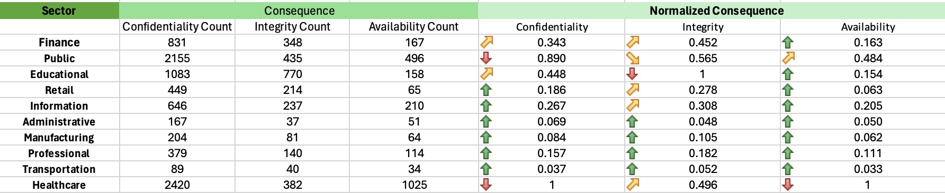
Risk analysis-Consequence
Consequence part of Risk Analysis:
Confidentiality – The limiting of access, use and/or control of information to only authorized users. Examples of a breach in confidentiality include data theft, and data disclosure.
Integrity – The trustworthiness and veracity of data. Examples of a breach in integrity include the modification of data files or very limited control over files, or data processes (e.g. control of a specific industrial control system).
Availability – Accessibility of data and/or data services. Examples of a breach of availability include distributed denial of service attacks, system encryption, and system hijacking.

Slide 21
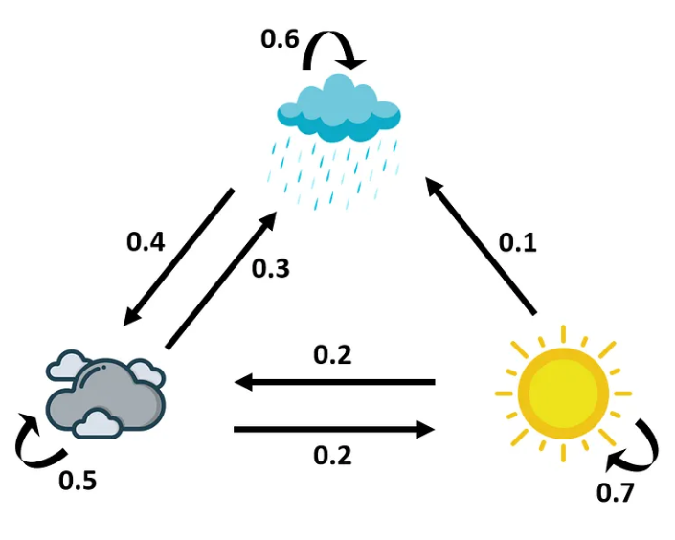
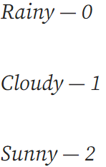
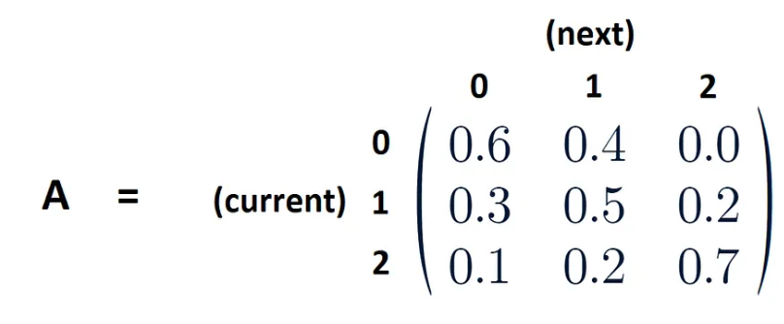
Vulnerability - Markov Chain analysis
Markov Chain
Example: Markov Chain for three states
A sequence of possible events in which the probability of each event depends only on the state attained in the previous event.
Markov chains can be described as memoryless.
Each transition is associated with a certain probability.
The sum of all the transition probabilities of a state should be equal to 1.
Source: https://ai.plainenglish.io/text-generation-with-markov-chains-in-python-da8a9d08f99d (Accessed: 02 April 2024).

Slide 22
Vulnerability - Markov Chain analysis
States represent the frequency of cybersecurity incidents.
Historical data is used to observe transitions between states.
Transition probabilities are calculated from the frequency of state changes.
State 0
State 1
State 2
State 3
0 Attack
1-5 Attacks
5-10 Attacks
10+ Attacks
Markov Chain Analysis for Healthcare
 | STATE 0 | STATE 1 | STATE 2 | STATE 3
STATE 0 | 0.125 | 0.625 | 0.125 | 0.125
STATE 1 | 0.0961 | 0.557 | 0.076 | 0.269
STATE 2 | 0.008 | 0.304 | 0.130 | 0.478
STATE 3 | 0.00 | 0.09 | 0.148 | 0.75
Got the frequency of LLM Attacks for the Healthcare Industry and we calculated the Markov chain using our model.

Slide 23
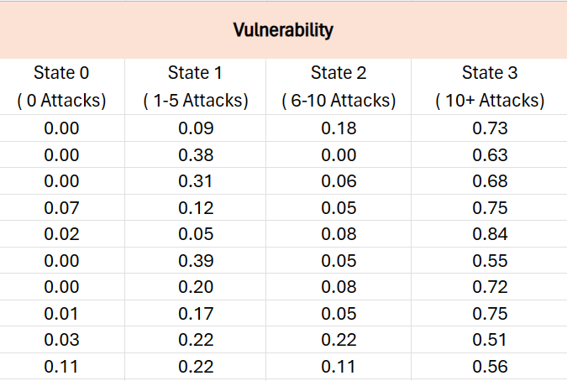
VULNERABILITY - MARKOV CHAIN ANALYSIS
Markov Chain Analysis quantifies the transition probabilities of sectors facing cyber-attacks, with states ranging from no attacks to a high number of incidents.
The Matrix:
State 0:
Baseline, no attacks
State 1:
Increased risk, initial breach phase
State 2:
Elevated risk, targeted threats
State 3:
High risk, critical vulnerabilities
For instance, the Finance sector shows a 73% chance of escalation to State 3, indicating an urgent security review. This data drives proactive cybersecurity strategy and resource allocation.

Slide 24
Risk assessment of LLMs
3 Components of LLM’s Risk Assessment
Threats
(Type of Attack)
Using LLM Attack Mapping, Probability of each type of attack is calculated.
Vulnerability
(Probability of an Attack)
Assess sector vulnerability to LLM attacks with Markov Chain Analysis.
Consequence
(How sector will be Affected)
In what ways, an LLM attack will harm the sector?

Slide 25
RISK ASSESSMENT OF LLMS​
Data Acquisition:
Uploaded incident data for the sector, including state-specific details.
Uploaded firm size data, including normalized values for each state.
Data Preparation:
Extracted and cleaned state codes in the incident data to ensure consistency.
Calculated the proportion of incidents for each state relative to the total number of incidents.
Data Integration:
Aligned firm size data by converting and matching state names with incident data.
Merged incident proportions with normalized firm size proportions based on state names.
Calculation: (Number of Incidents / Total Incidents)×(Number of Firms /Total Firms)×Weighting Factor to derive a preliminary risk metric.
Normalization:
Normalized the calculated risk values to scale between 1 and 100, using the maximum value as a reference.
Output and Visualization:
Generated "Statewise Risk Calculation" CSV file with final normalized risk values.
Uploaded CSV file on Tableau.
Mapped normalized risk values on a USA map in Tableau for visual analysis.

Slide 26
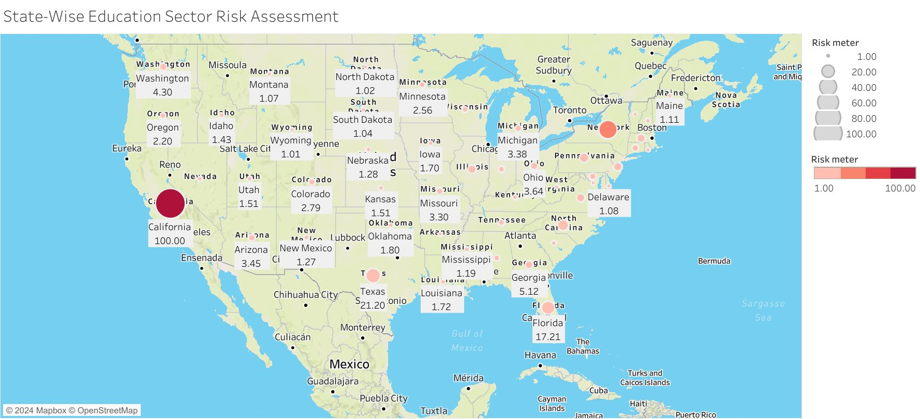
Risk assessment of LLMs
LLM Attack Risk Factor by Location
Notes:
No. of firms/

Slide 27
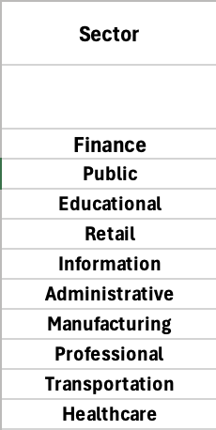
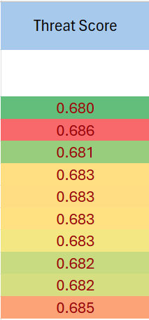
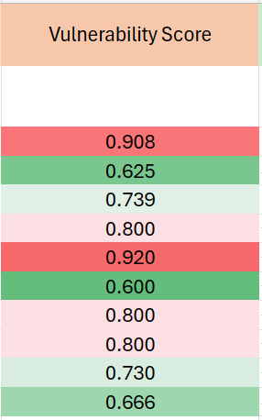
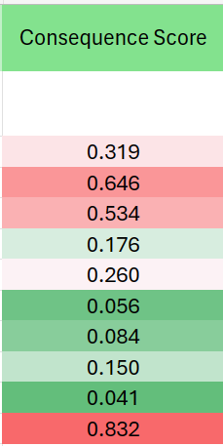
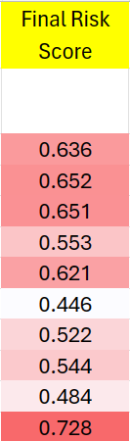
Risk Assessment of LLMs
Risk Assessment Tool for Various Sectors
P(At least one attack)=1−∏i=1n (1−P(Attack i))
Sum of probability of State 2 and State 3.
Average of Confidentiality, Integrity and Availability.
Average of the Scores

Slide 28
Key Learnings
LLM Vulnerability Surge: Post-ChatGPT 3.5 launch saw a spike in news coverage highlighting LLM vulnerabilities, emphasizing the need for robust security.
Proactive Risk Assessment: The surge underscores the importance of tailored risk assessment for AI systems, facilitating proactive threat mitigation.
Dynamic Threat Landscape: Continuous monitoring and adaptation of security measures are vital in response to the dynamic nature of LLM threats.
Collaboration for Mitigation: Industry collaboration and information sharing are crucial for staying ahead of evolving LLM threats.
Ethical Deployment Focus: The rise in attacks underscores the importance of ethical AI deployment practices to ensure responsible use of AI technologies.

Slide 29
Q & A
Thank you! ​
Q & A

